Slide 1
Chat Bot Using Semantic and Sentiment Analysis
By,
Balaji S(2018103014) Dhananjeyan AK(2018103523) Vijay JA(2018103622)

Slide 2
What’s happening inside?
This interactive chat bot which focusses on domain of cricket game and answers user questions and responds according to user emotions.
Steps involved are tokenizing , stemming ,lemmatizing , lexical semantics , sentiment analysis and ambiguity reduction.
Response is based on Term frequency ( Scoring of frequency of word in current document) and Inverse document frequency (Scoring of how rare the word is across dataset )
To reduce ambiguity , we used the approach of cosine similiarity which is a statistical measure used to evaluate how important a word is to a collection or corpus…
Mathematical formula ( Dot product of d1 and d2 ( ||d1|| . ||d2||) where d1 and d2 are bag of words (vectors)

Slide 3
Abstract
In today’s tech-savvy world, chatbots have become a popular tool for companies. Businesses, both big and small, have found ways to use chatbots to provide assistance for their customers. Need for chatbots are getting increased day by day. Chatbots saw tremendous growth in 2017, even earning it the title “year of chatbots”. The good news is that this growth is continuing, helping businesses provide the best customer service and grow their business by connecting with consumers in real-time. The use of chatbots in business will evolve in the coming years – the design and architecture inevitably improving. Here it deals with CrickBot (a cricket domain ontological Question answer system ) powered by semantics and sentimental analysis.

Slide 4
A literary survey
S.no | Journal | Author and publication | Methodology | Advantages | Limitations
1. | An Approach to Enhance Chatbot Semantic power and Maintainability (September 2012) | Agnese Augello (Italian National Research Council) | Pyramidal hierarchy of considering and answering user questions in an AIML knowledge base approach and corpus of data based on FAQ | Domain Ontology principle maintained – to realize a user friendly QA system on a very speciﬁc domain documented and question analysis done | Sentimental questions and feedbacks for them are not covered which remained as a lag of natural conversation
2. | Chatbots for education system (2018) | Hiermath Guruswami (Pune institute of technology) | Response generation via POS(part of speech) tagging, pattern matching ,Machine Learning | Automated response system by extracting keywords from both static database and Internet | This was more like a normal interactive machine and not based on specific ontology which may fail on business purposes

Slide 5
S.no | Journal | Author and Publication | Methodology | Advantages | Limitations
3. | A Smart Chatbot Architecture based NLP and Machine Learning.. | Soufyane Ayanouz and Mohammed Benhmed(Morocco). | The main research includes intention identification and information extraction using Natural Language Processing(NLP) | The new development in this area and the new wave of thinking have the potential to entirely change the experience of customers to provide the best services in such a way that echoes with the modern customers. | The existing chatbots are bad at suddenly changing any chatbots respond without any context so we cannot achieve a satisfactory level of accuracy

Slide 6
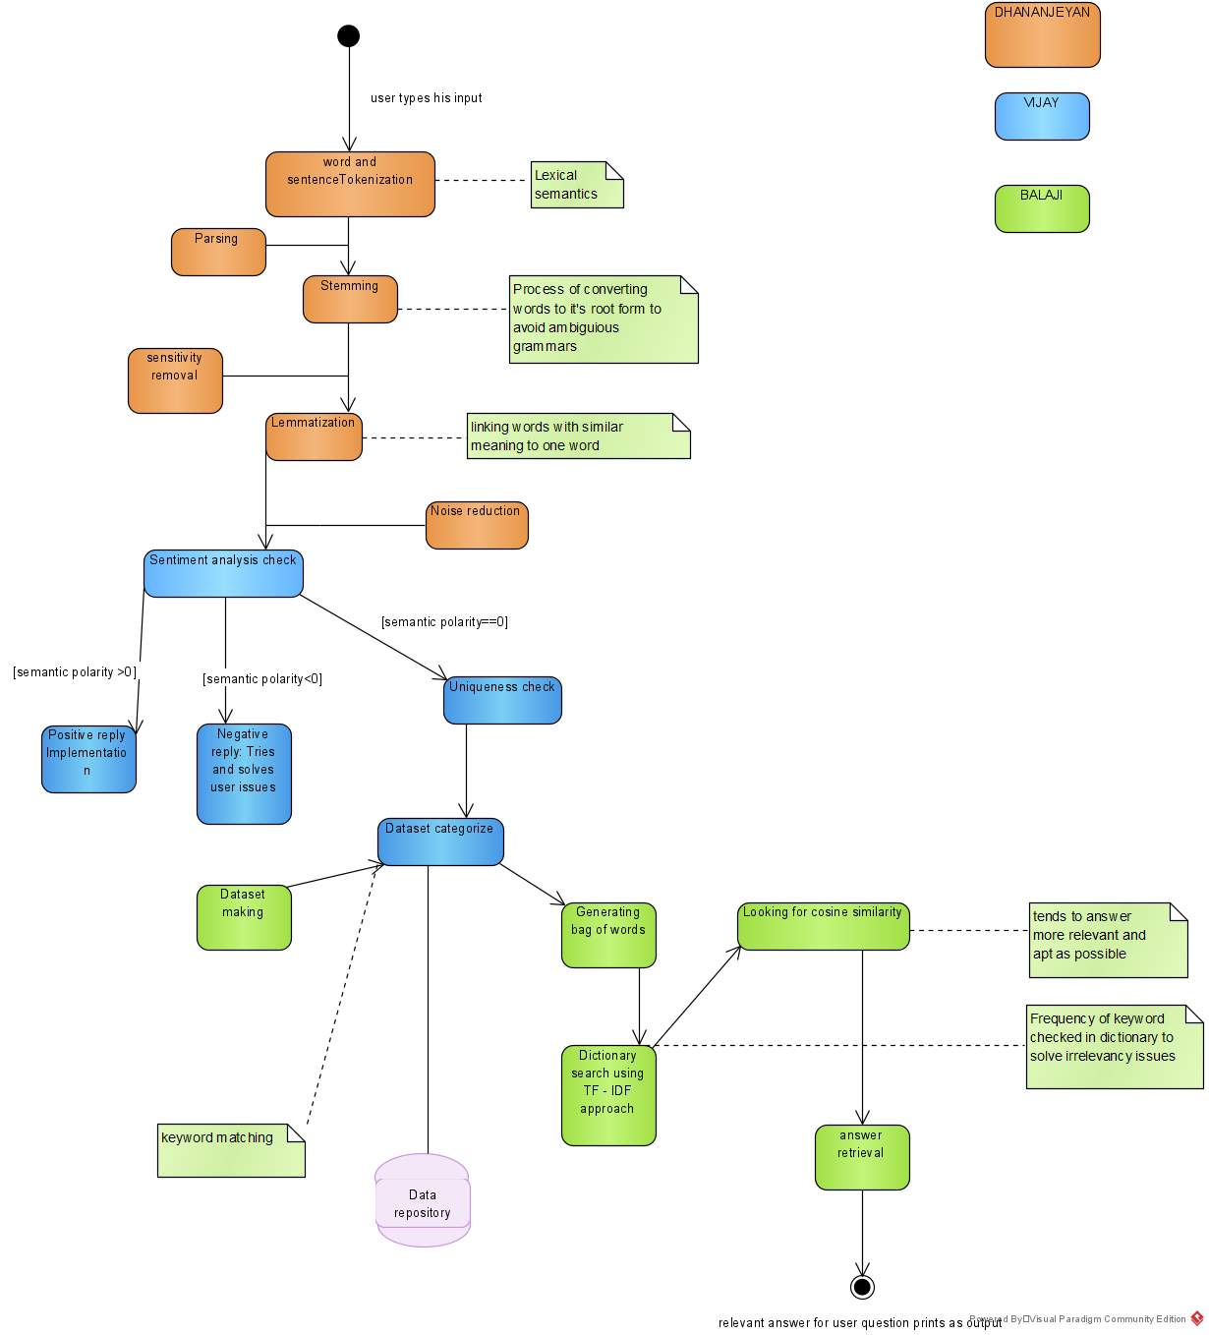
Architectural Diagram

Slide 7
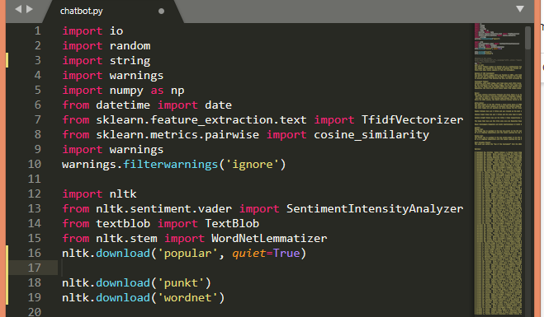
Language and Packages
LANGUAGE USED: PYTHON
CONCEPT: NLP & SEMANTIC ANALYSIS
Num py
Vectorizer
Nltk
Sentiment Analyzer
Lemmatizer

Slide 8
Module1 : Lexical Phase: (Content Scrapping)
PHASE 1: TOKENISATION AND CLEANSING
The input which is received from user is first tokenised to obtain keywords, which is essential for answer retrieval from datasets..
Lexical Semantics is applied to obtain keywords and the words are then cleansed.
Stop word removal : Unnecessary words like the, is, was etc. are removed and processed in such a way to help chat bot to recognise the questions
Then , the words are parsed and undergo the process of:
TEXT NORMALISATION:
Stemming: Stemming is the process of reducing inflection in words to their root forms such as mapping a group of words to the same stem even if the stem itself is not a valid word in the Language..
Eg. Playing, played ,has been playing all becomes root word play

Slide 9
PHASE 2: LEMMATIZING,SUFFIX STRIPPING,SENSITIVITY AND NOISE REMOVAL
Case Sensitivity in words is removed and word is made to lower form
Lemmatization is the process of grouping together the different inflected forms of a word so they can be analysed as a single item. Lemmatization is similar to stemming but it brings context to the words. So it links words with similar meaning to one word.
So, the keyword is made into context as per the requirement and processed to further refinement.
Suffix-Stripping is used to remove suffix in words which is unnecessary
Further noise reduction in words is made (stop words, unnecessary metaphors removed)

Slide 10
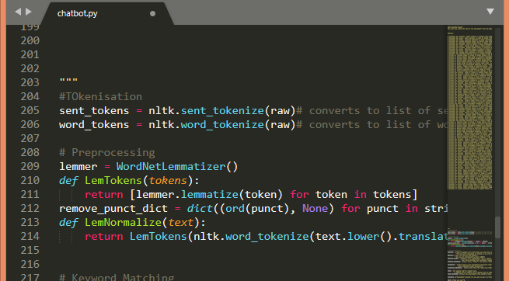
Lexical Phase: (Content Scrapping)
Pseudocode:
input=get_input()
input.lower()
sentence_tokenize()
word_tokenize()
for token in tokens:
lemmatize(token)
remove_punct_dict()
def normalize:
return Lemtokens(nltk.word_tokenize(text.lower().removepunct())

Slide 11
Module 2 :
Sentiment Analysis Check:
The next step is to improve user experience. After all, it isn't enough to just provide the right answers, you want to create a delightful experience for users. With the help of sentiment analysis, chat bots could understand whether the conversation was going well and respond to customer emotions accordingly.
The most basic form of analysis on textual data is to take out the word frequency. A single question is too small of an entity to find out the distribution of words, hence, the analysis of the frequency of words would be done on all positive tweets.

Slide 12
POSITIVE AND NEGATIVE RESPONSES
A measure to find the intensity of words – whether positive or negative is fixed known as Semantic Polarity
Keywords are stored as key-value pairs with semantic polarity as values.
Inputs are made into TextBlobs which are objects used for text processing in NLP.
SentimentIntensityAnalyzer is called into play and textblob.intensity() is evaluated.
If polarity is positive, it reveals that it is a positive response. In that case, a random positive and enthusiastic reply is given by chatbot using random.choice() function
Else, focus is given on asking about why the user is not interested looking on to negative response answering dictionary

Slide 13
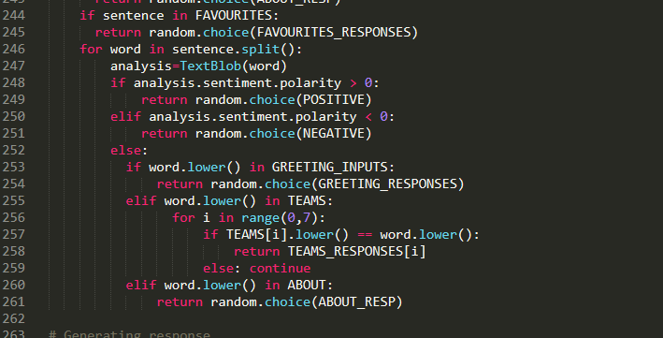
Sentiment Phase
Pseudocode:
def semantic:
Importing SentimentAnalyzer and considering a textblob
analysis <- textBlob(word)
If analysis.semantic polarity >0:
Return positivedict[pick_value.random()]
Else if analysis.semantic polarity <0:
Return negativedict[pick_value.random()]
Else:
keyword=analysis.strip()
Search the textfile:
If keyword found in textfile:
Undergo cosine similarity and frequency calculations
Else
Ask user about details { Apologies dictionary used}

Slide 14
Module 3: Semantic Phase(Answer Generation)
After the initial pre-processing phase, we need to transform text into a meaningful vector (or array) of numbers. The bag-of-words is a representation of text that describes the occurrence of words within a document. It involves two things:
A vocabulary of known words.
A measure of the presence of known words.
For example, if our dictionary contains the words {Learning, is, the, not, great}, and we want to vectorize the text “Learning is great”, we would have the following vector: (1, 1, 0, 0, 1).
We use following two approach to penalise more frequent but non informational words.
Term Frequency
Inverse Document Frequency

Slide 15
TF-IDF and COSINE SIMILARITY APPROACH
Term Frequency: is a scoring of the frequency of the word in the current document.
TF = (Number of times term t appears in document)/(Number of terms in document)
Inverse Document Frequency: is a scoring of how rare the word is across documents.
Inverse Document Frequency: is a scoring of how rare the word is across documents.
IDF = 1+log(N/n) [N-number of documents and n is number of documents where t has appeared in]
This weight is a statistical measure used to evaluate how important a word is to a document in a collection or corpus
Document Similiarity is looked upon and answer is based on these factors. If it could’nt find answer,it requests users to be more precise
Cosine Similarity (d1, d2) = Dot product(d1, d2) / ||d1|| * ||d2||

Slide 16
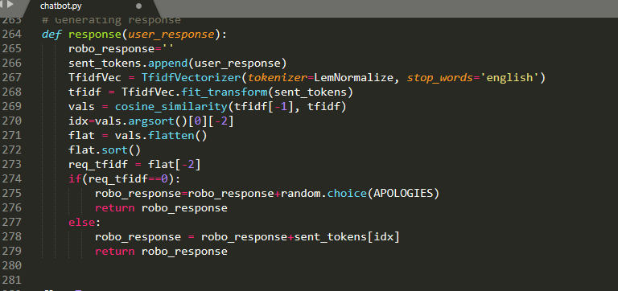
Semantic Phase(Answer Generation)
Pseudocode:
def userResponse:
if sentence <- ABOUT:
Answer(about_resp)
Else if sentence <- Greetings:
Answer(greeting_resp)
Else:
append tokens and normalize
Vectorize keywords and transform to root (Stemming)
[Tfidfvec=Vectorizer()] { TF/IDF approach used }
Cosine Similarity:
vect=Tfidf transformed to roots {Stemming and Lemmatizing}
cosine_similarity(vect[-1],vect);

Slide 17
References
C. J. N. J. S. S. Divya Madhu, "A novel approach for medical assistance using trained chatbot," in International Conference on Inventive Communication and Computational Technologies (ICICCT), 2017.
[2] S. A. N. H. Hameedullah Kazi, "Effect of Chatbot Systems on Student’s Learning Outcomes," SYLWAN, 2019.
[3] BORKAN, "www.blog.casper.com," 21 september 2016. [Online]. Available: https://blog.casper.com/meet-insomnobot-3000/.
[4] D. B. Mesko, "The Medical Futurist," The Medical Futurist Institute, 2020. [Online]. Available: https://medicalfuturist.com/magazine/.
[5] Saurav Kumar Mishra, DhirendraBharti, Nidhi Mishra," Dr.Vdoc: A Medical Chatbot that Acts as a virtual Doctor", Journal of Medical Science and Technology, Volume: 6, Issue 3,2017.
[6] Abdul-Kader Sameera, John Woods, "Survey on Chatbot Design Techniques in Speech Conversation Systems", (IJACSA) International Journal of Advanced Computer Science and Applications, vol. 6, no. 7, 2015.
[7] S. Divya, V. Indumathi, S. Ishwarya, M. Priyasankari, S. Kalpana Devi, "A Self-Diagnosis Medical Chatbot Using Artificial Intelligence", J. Web Dev. Web Des., vol. 3, no. 1, pp. 1-7, 2018.
[8] Ryuichiro Higashinaka et al. Towards an open domain conversational system fully based on natural language processing. In COLING’14, pages 928–939, 2014.
[9] Bayu Setiaji, Ferry Wahyu Wibowo, "Chatbot Using A Knowledge in Database", 7th International Conference on Intelligent Systems Modelling and Simulation, 2016

